Slide 1
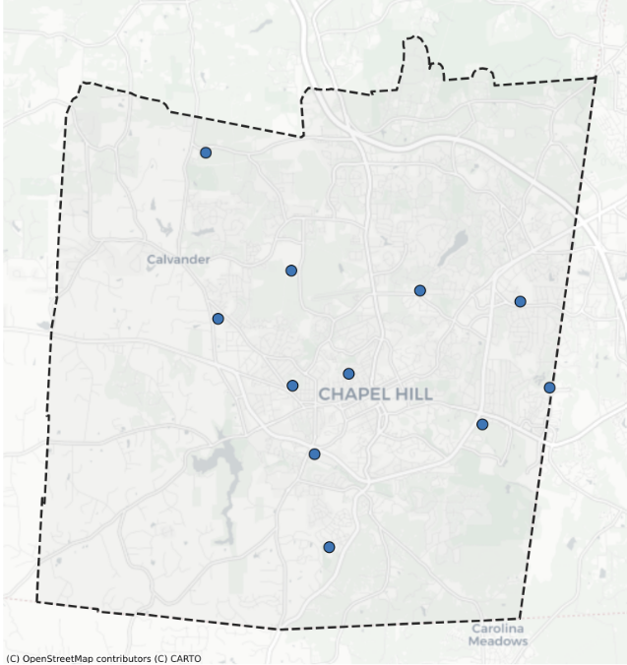
CHCCS Map Analysis
&
Demography Updates

Slide 2
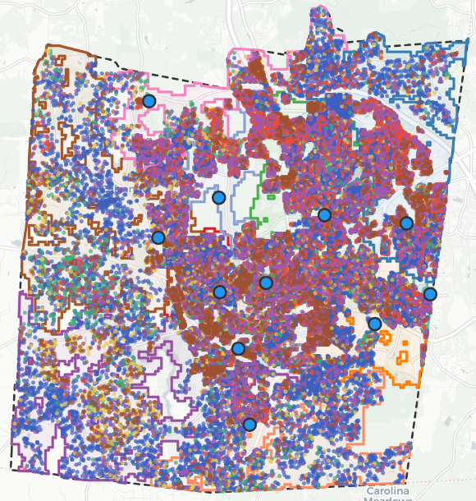
Where Do
People Live?
Where Are
the Schools?
Notes:
Large blue dots = CHCCS elementary schools
Color dots = people
No dots = no people

Slide 3
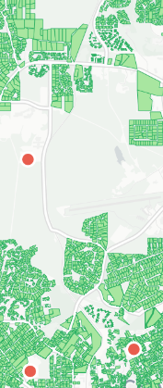
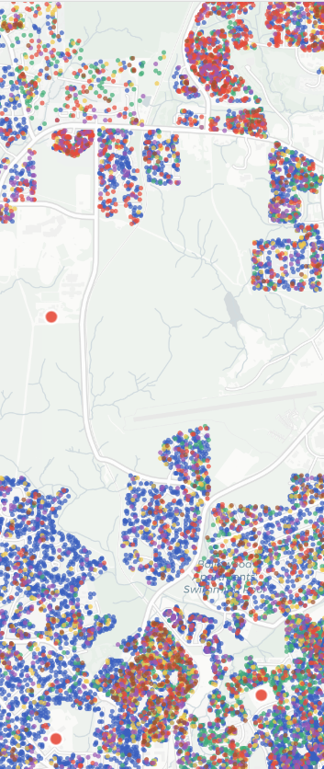
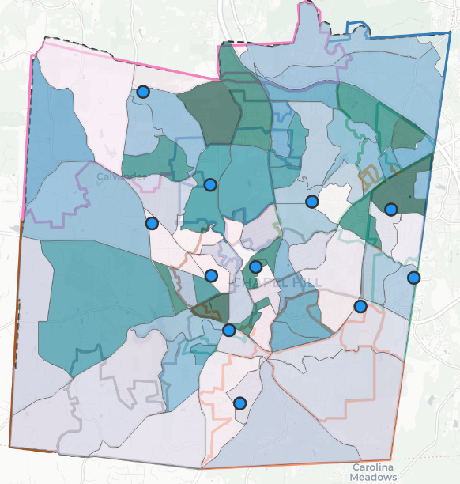
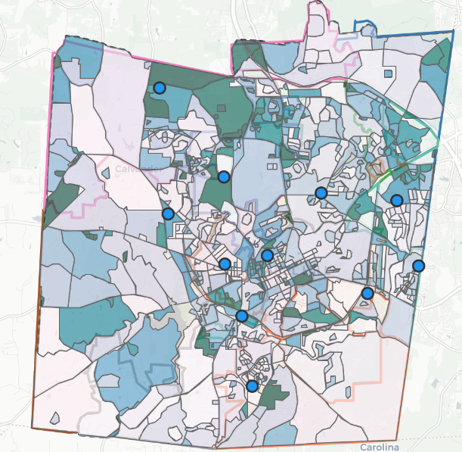
Who Lives Where?
ACS Block Group demographics
ACS Census Block population distribution
Dasymetric mapping with Orange County parcels
High resolution “population dots” for all categories
Notes:
Methodology

Slide 4
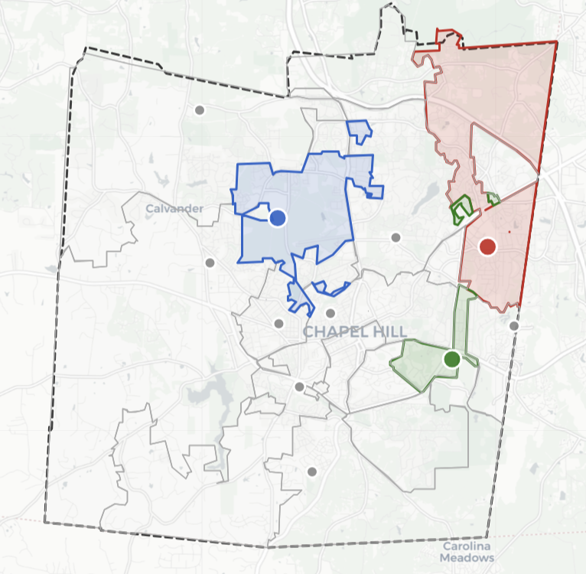
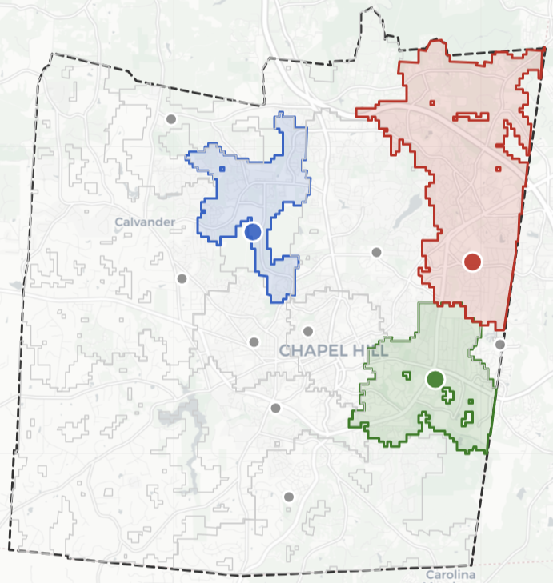
Attendance Zones (temporary) to “Drive Zones”
Current CHCCS Attendance Zones
Nearest “Drive Zone” School
Notes:
Schools considered for closure: Ephesus (red), Glenwood (green), Seawell (blue)
Drive zone answers “If every family drove to the closest school, which school would serve this location?”
Large drive zone = more accessible to more people
Odd borders/holes shaped by road networks, inaccessible areas, and neighboring territories of other schools

Slide 5
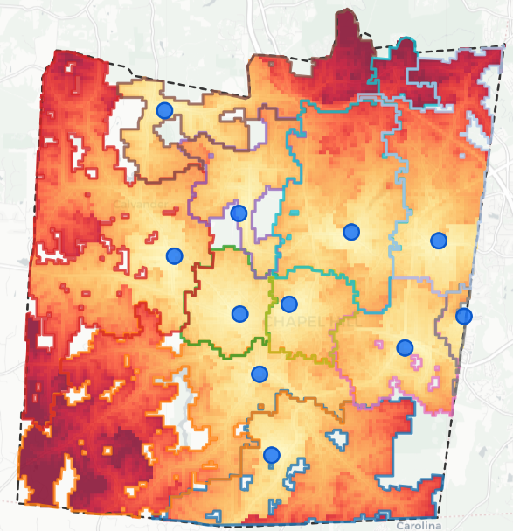
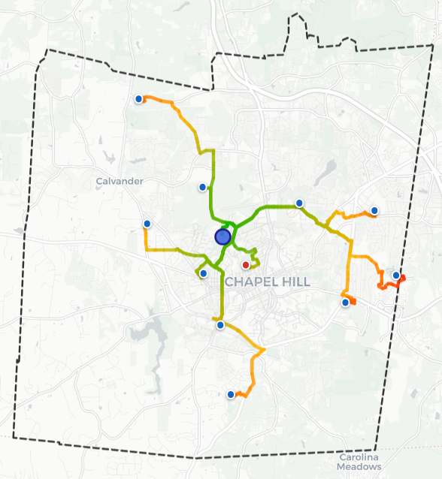
Connecting People
to Schools…
Travel time from every location in CHCCS district to every school using:
Road networks
Stop lights / signs
Dijkstra routing

Slide 6
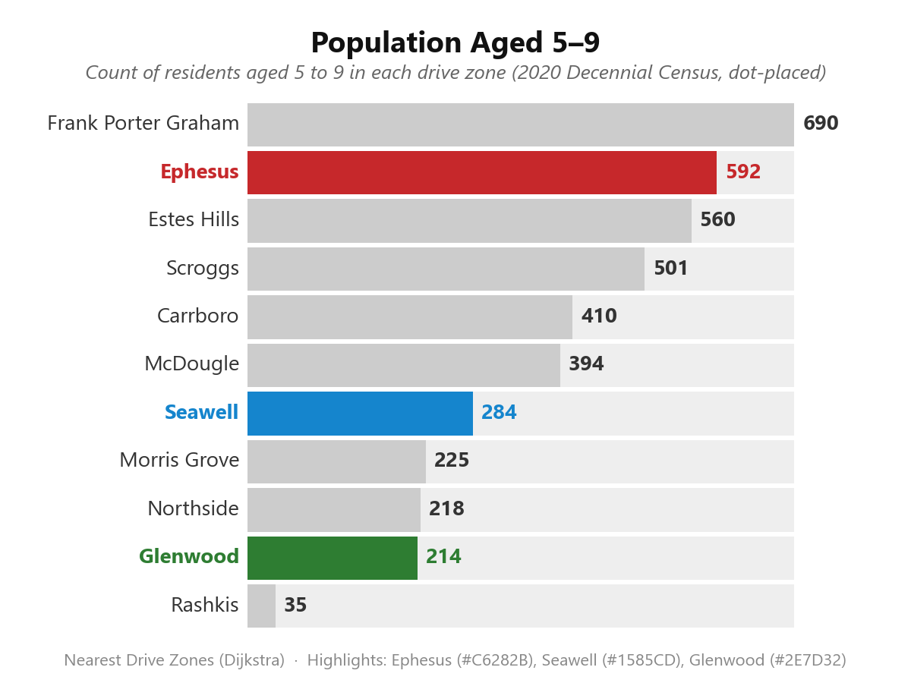
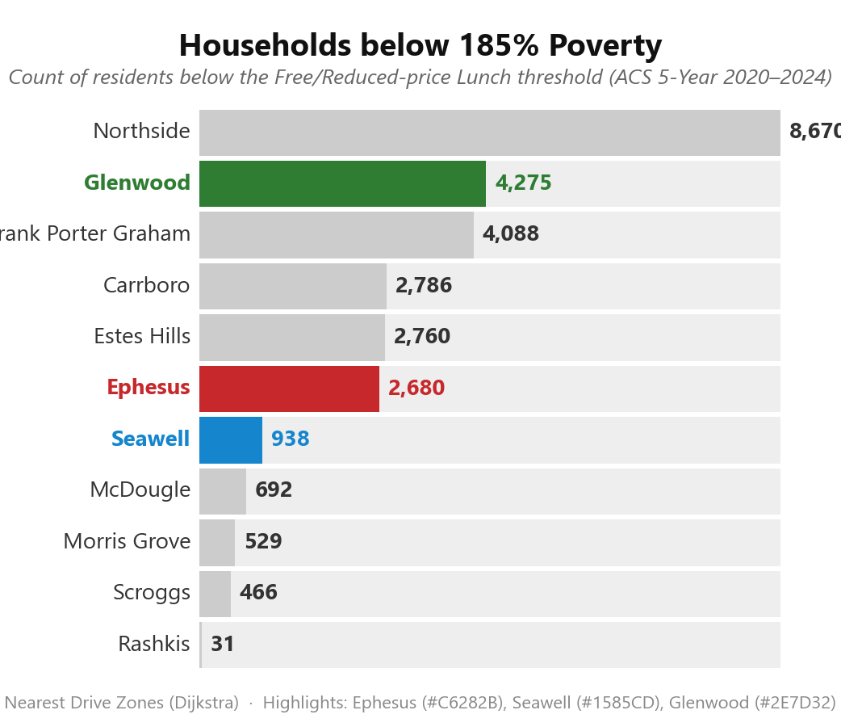
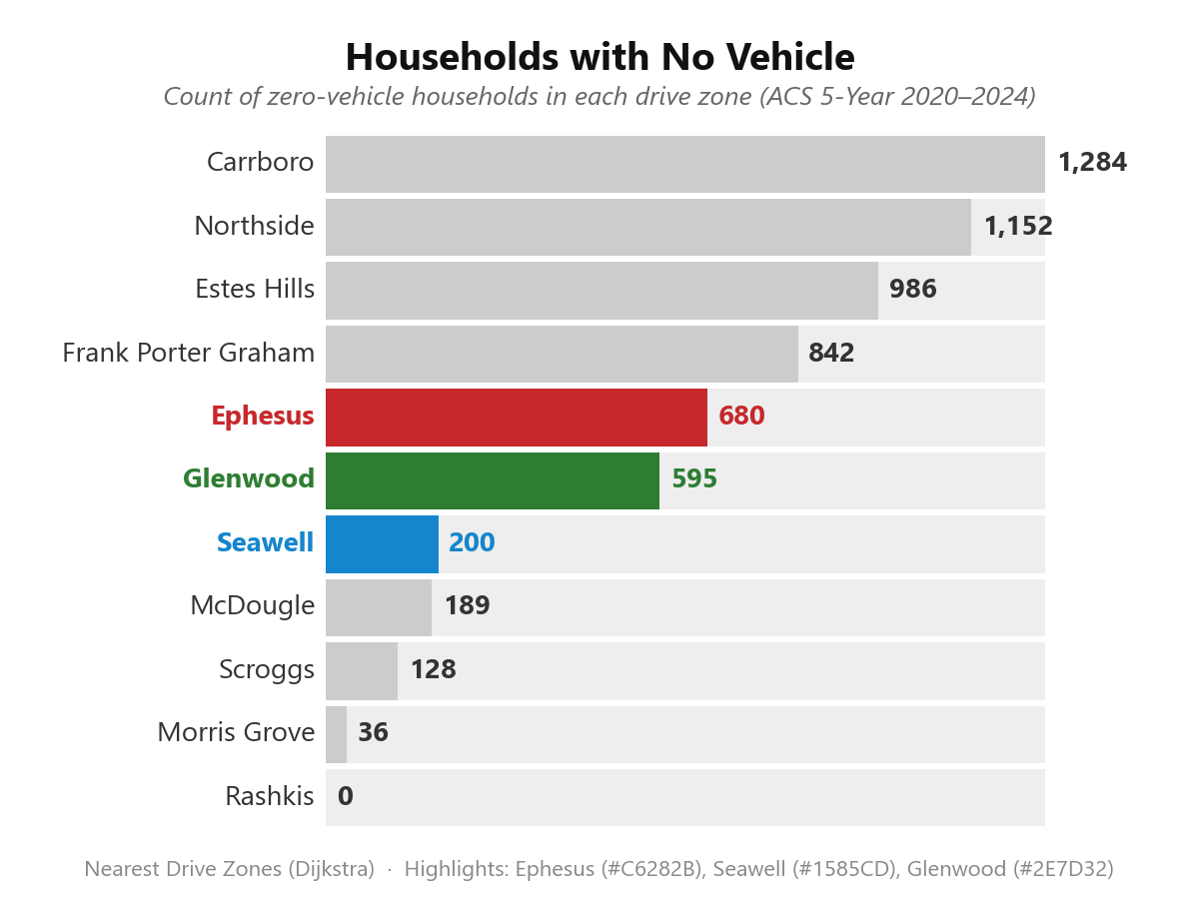
Who’s Affected?
Drive zones show objective data for surrounding neighborhoods
Demographics are more relevant data for the enrolling neighborhood school (not magnet)
Notes:
ACS Census Data

Slide 7
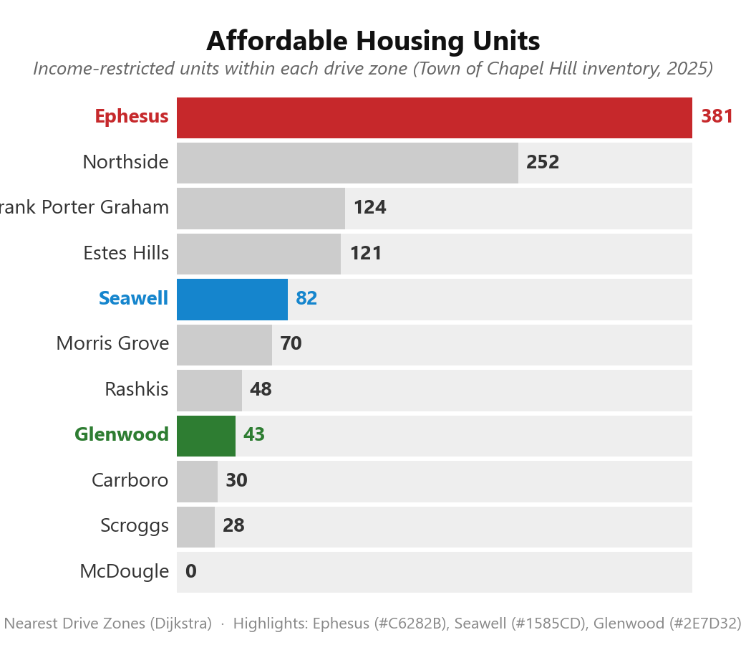
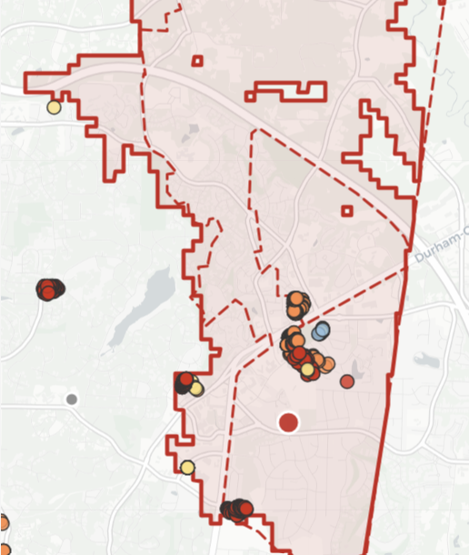
Who’s Affected?

Slide 8
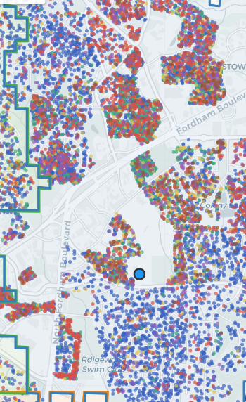
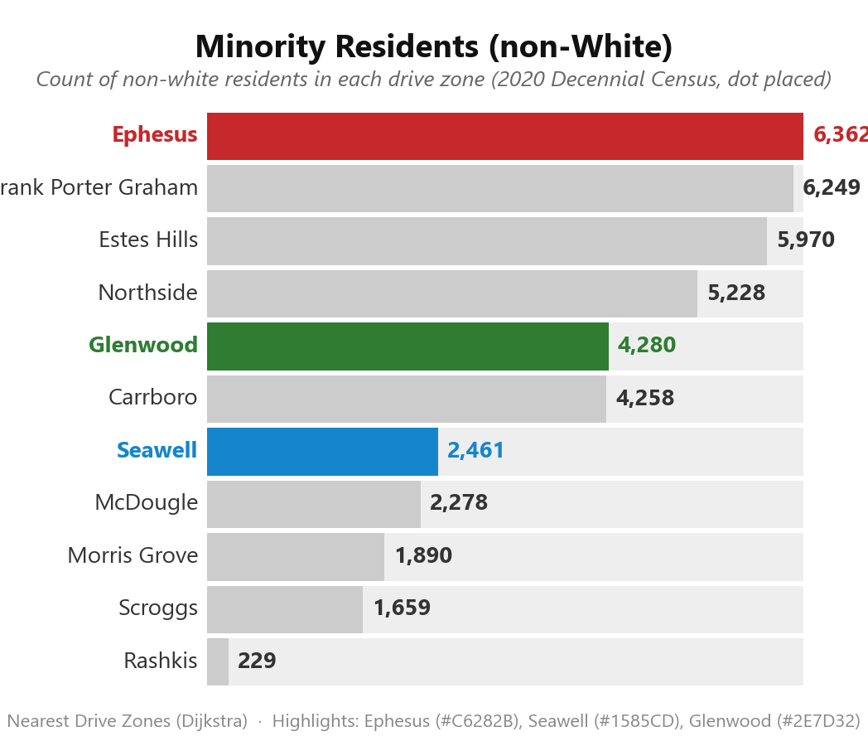

Who’s Affected?
Notes:
ACS Census Data

Slide 9
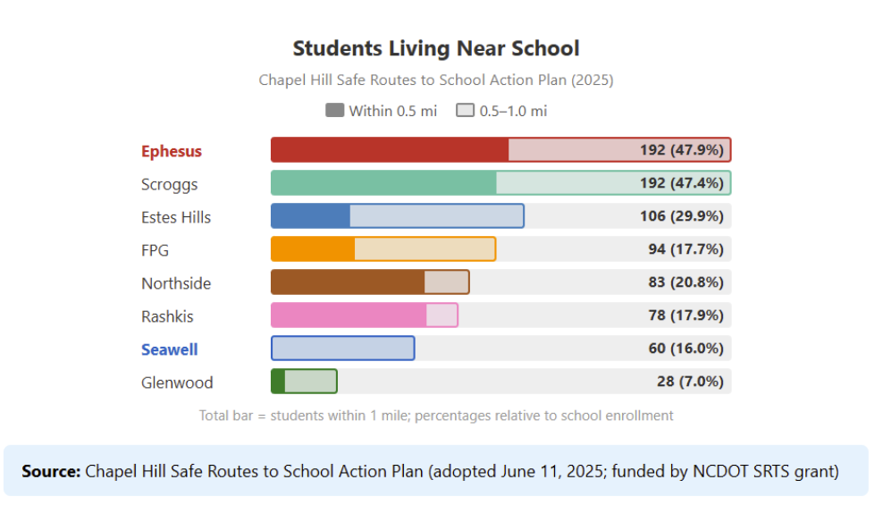
$900/student to ride bus each year

Slide 10
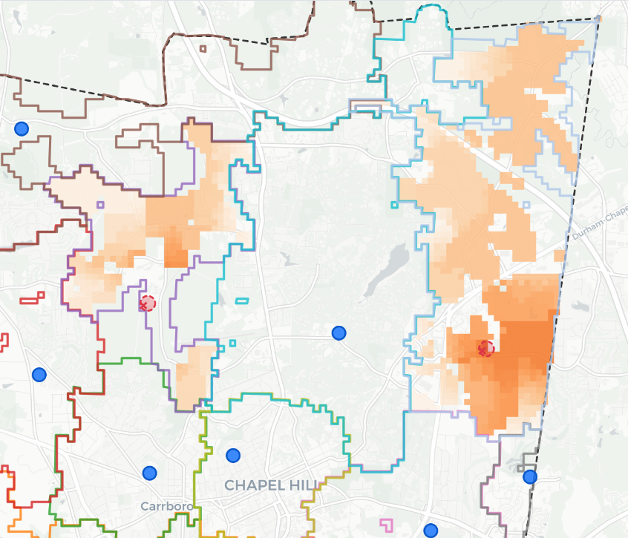
Change in Travel Time
(School Closures)
How much farther is the new nearest school?
Seawell to Morris Grove or Estes (+5 mins)
Ephesus to Estes Hill (+7 mins) or Rashkis (+11 mins)
Darker colors = more time added to commute
Notes:
Glenwood not included due to primarily magnet program/enrollment (dificult to understand travel patterns)

Slide 11
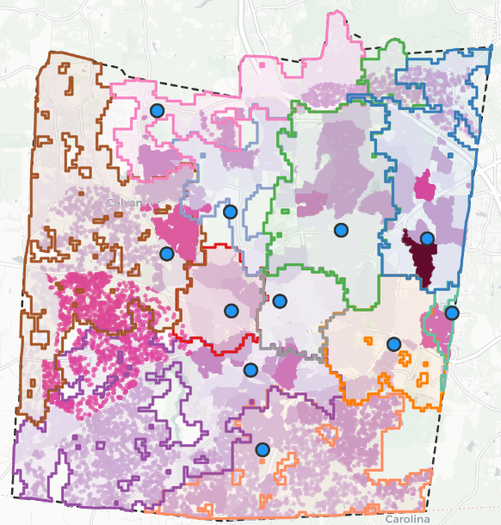
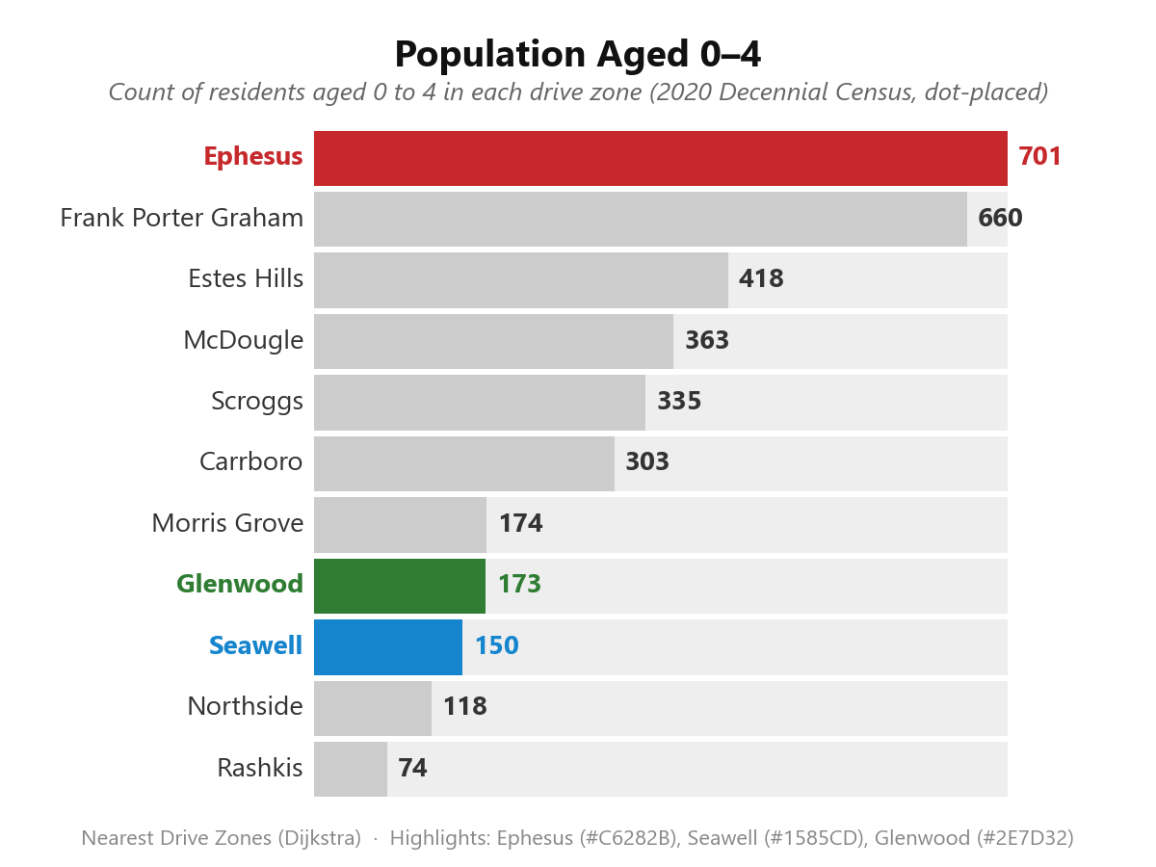

Where is Future Growth? (0-4 year olds)
Notes:
ACS Census Data

Slide 12
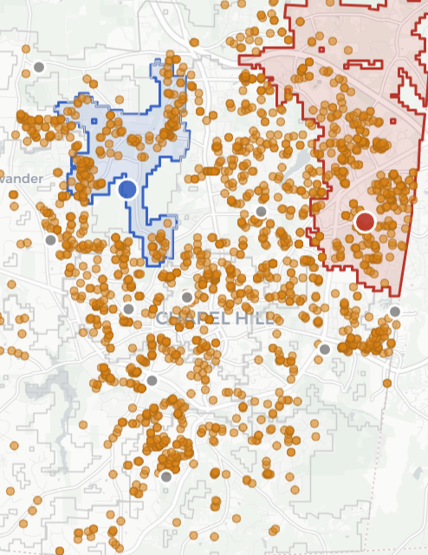
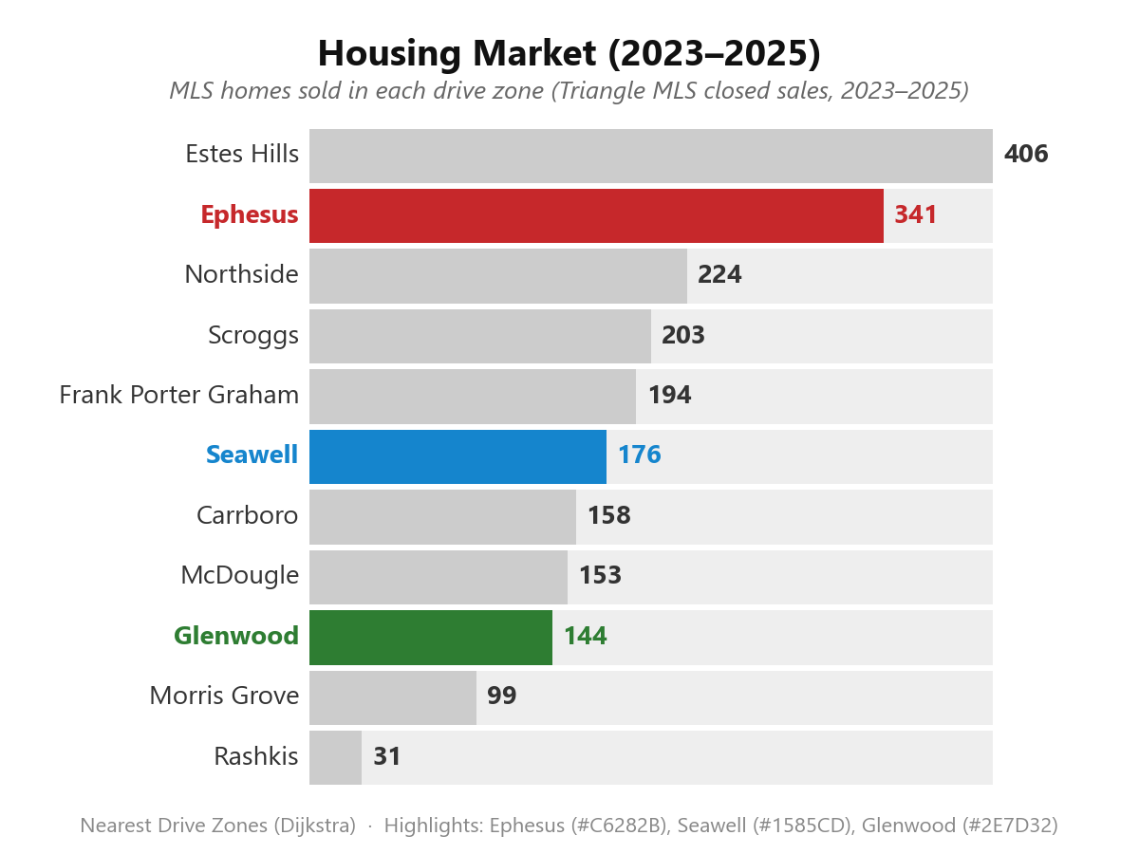
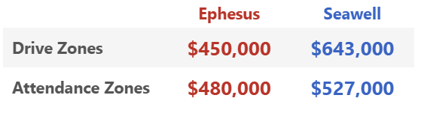
Where is Future Growth? (Home Sales)
Notes:
MLS Data 2023-2025

Slide 13
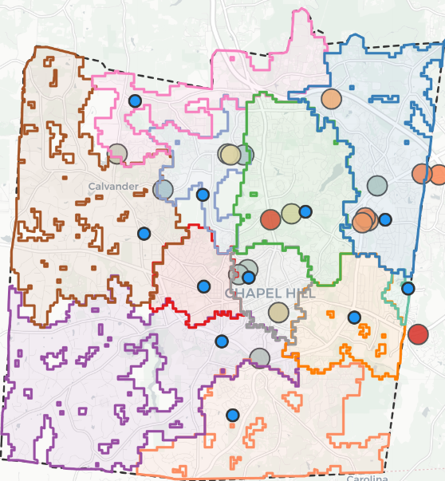
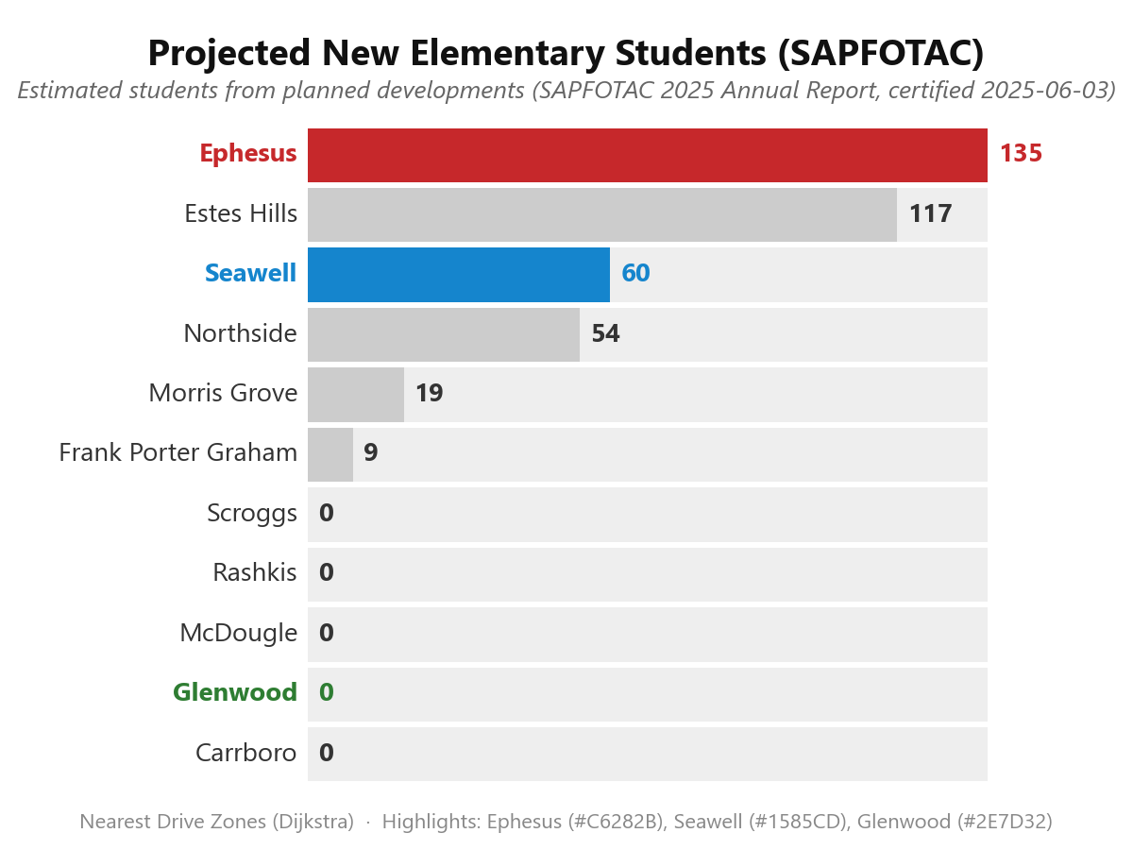
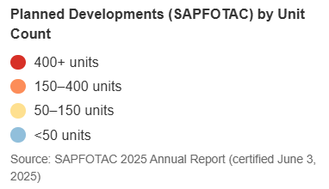
Where is Future Growth? (NC State Projections)
Notes:
SAPFOTAC Annual Report 2025

Slide 14
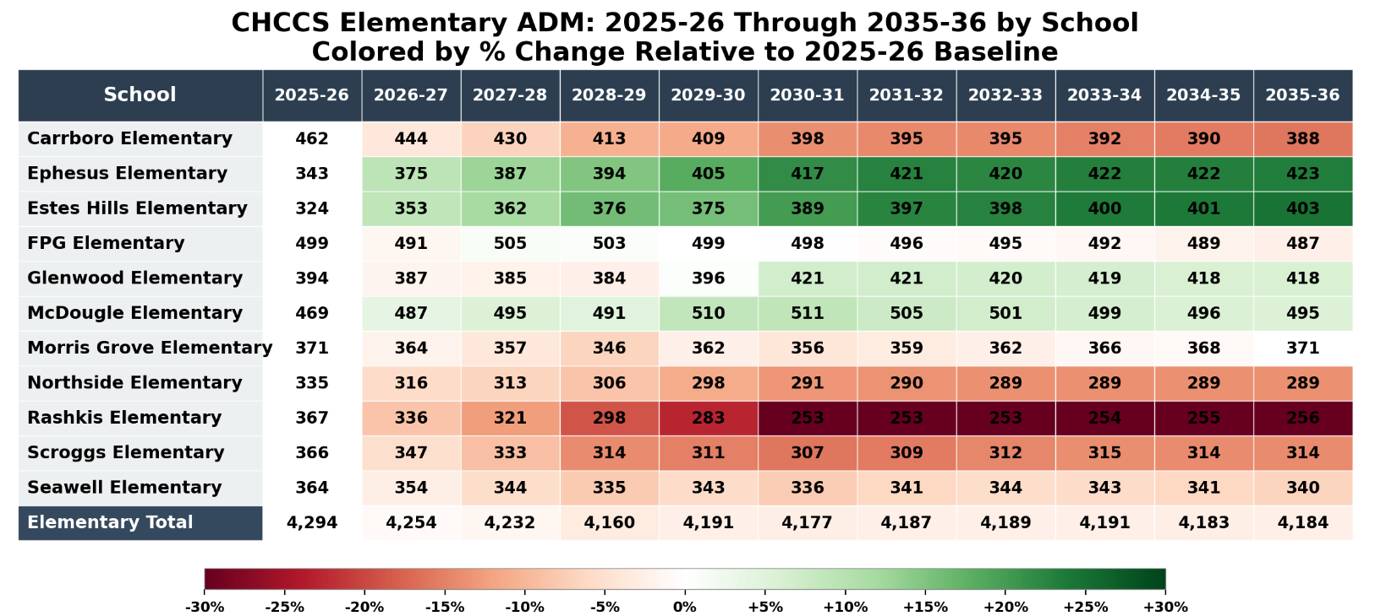
Ephesus Naturally Sustains Enrollment
Notes:
Latest Carolina Demography Report

Slide 15
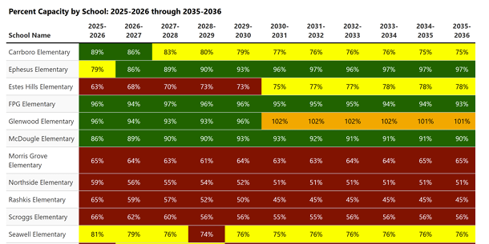
Ephesus Naturally Sustains Enrollment
Notes:
Carolina Demography Report

Slide 16

CHCCSAction.org
Visit our website to see even more maps!!!!
Interactive maps
Methodology maps
Story maps
For optimal viewing experience, open on a computer [full screen]

Slide 17
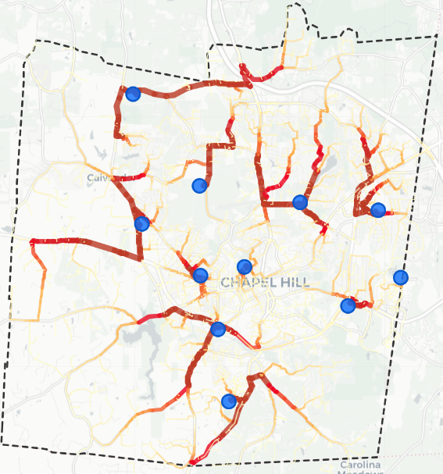
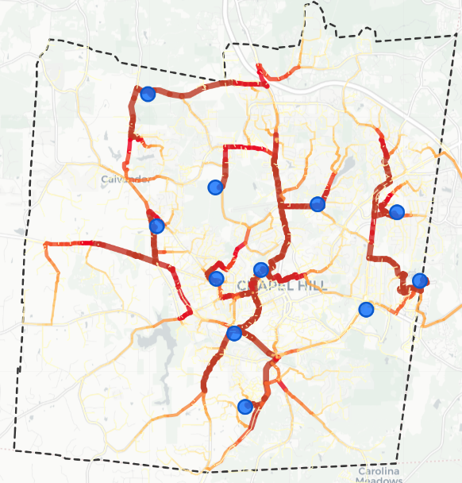
Traffic and Increased Burden
Nearest “Drive Zone” School
Current School Zones

Slide 18
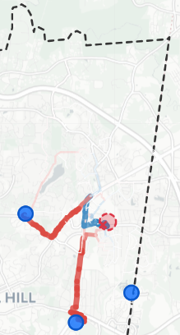
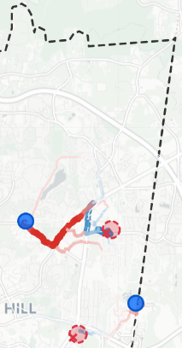
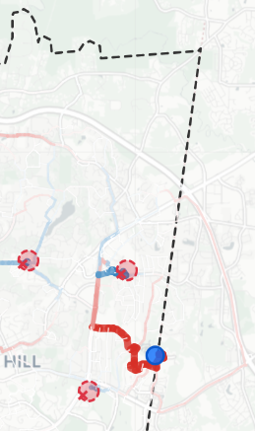
School Closure Scenarios:
what is the actual closest school?
Close Ephesus
Close Ephesus
+ Glenwood
Close Ephesus
+ Glenwood
+ Estes
Estes and Glenwood are closer to Ephesus
So the only way to “trick” the algorithm into sending students from Ephesus to Rashkis to also close Estes and Glenwood
This adds up to 11 minutes of drive time for Ephesus families (total commute time is longer)

Slide 19
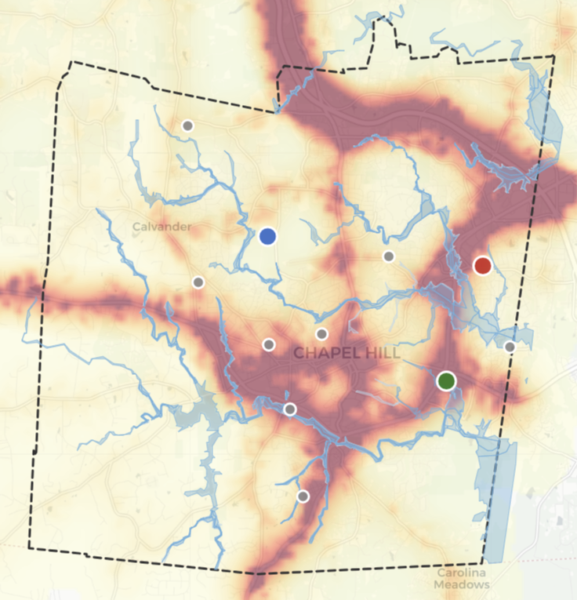
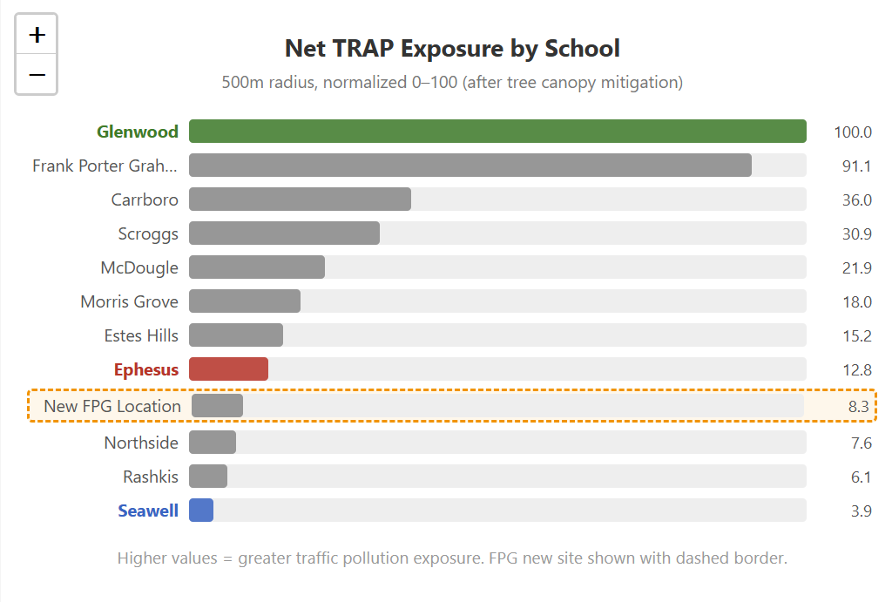
Flood plains, TRAP Exposure, Urban Heat Map

Slide 20
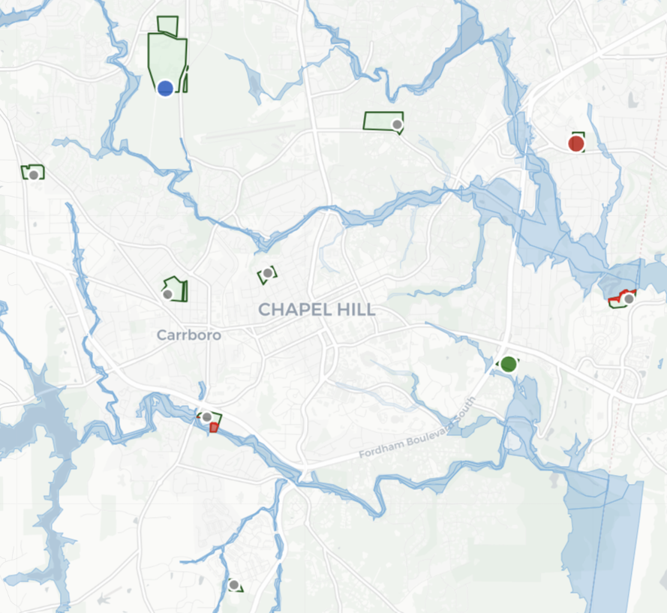
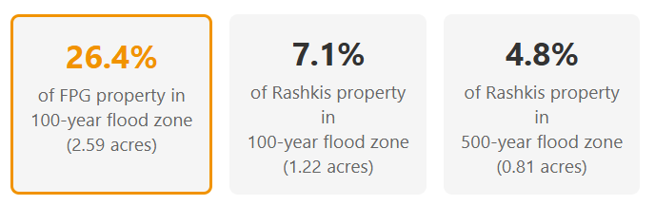
Flood Risk

Slide 21
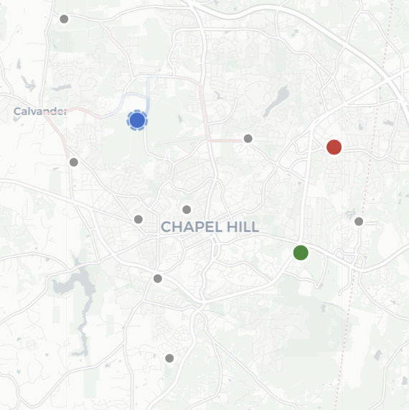
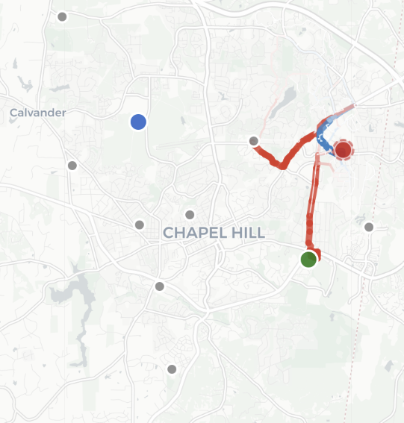
Closure Impact on Traffic

Slide 22
